Slide 1
Drone Conversion Appliances (DCA)
Date: 10 March 2023
DCA Team
Project Advisor: Dr. Yongcan Cao, ECE
Team Sponsor: USL Lab, UTSA
Team Members: Ehab Afsoonko, Conrad Obeng, Lexi McMinn, Mark James Jr., Matthew Moubray
“Expanding the world of Modifiable Drone Transit.”

Slide 2
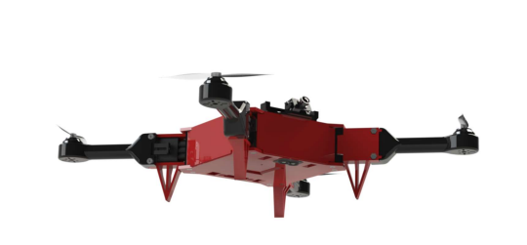
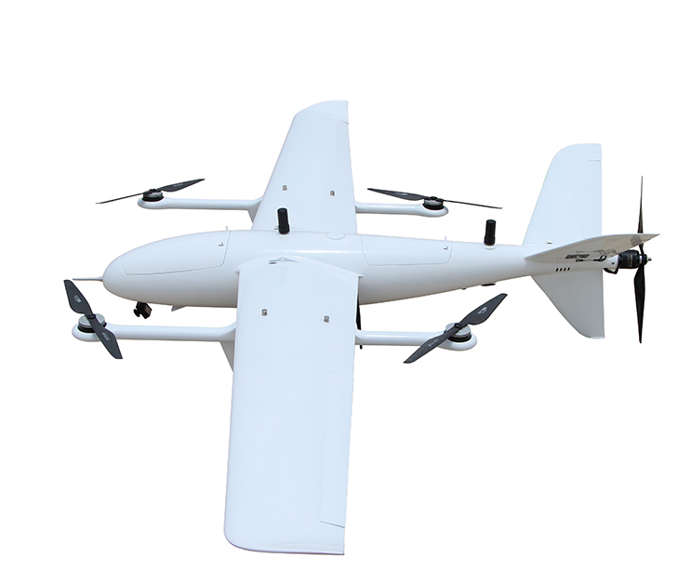
Background/Overview Slide
Every UAV, drone, or RC plane on the market is a single modality kit and constrained to a single flight pattern. Our project aims to expand the number of vehicle transportation modalities for the ModiFly Quadcopter through the addition of a VTOL Fixed-Wing module. This will allow for user to take the mainframe from the Modifly Quadcopter and attach the VTOL Fixed-Wing module without the need to purchase and build a whole entire kit. The VTOL-Fixed WIng module features are:
Longer flight duration
Reduced battery consumption
Vertical-Takeoff and Landing capability
Higher forward propulsion
Increase payload

Slide 3
Tasks Completed
Finalized design of new quadcopter base
Completed first test flight in quadcopter mode
Assembled ModiFly Frame
Wired motor mount connectors
Soldered 4:1 ESC
Flashed Pixhawk
Changed Ardupilot parameters
H-bridge drone frame
Pixhawk orientation/GPS
Virtual Motor PID Position
ESC Protocol
Assembled VTOL wingframes

Slide 4
Current Problem or Obstacles Slide
How to attach wings securely to quadcopter base?
How to make the front propellers tilt forward without catastrophic failure during transition from VTOL mode to forward-flight mode?

Slide 5
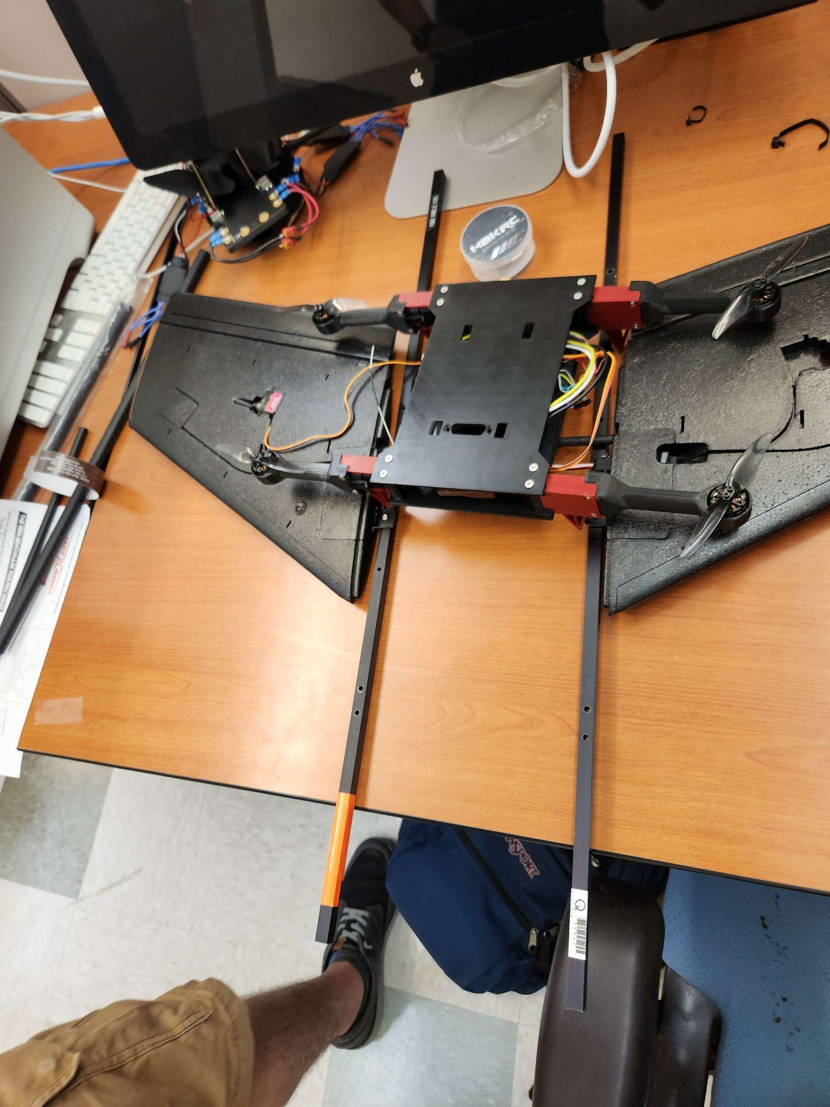
Example of Final Product
This is what the final design will roughly look like. The base is currently configured for quadcopter mode, but the propellers will have larger blades and will be located near the end of the beams. They are attached to a piece of carbon fiber that is inside of the wings themselves. New connections will be fixed to these beams to ensure the “plug and play” compatibility with the Modi-fly Ecosystem.

Slide 6

First Drone Flight Test

Slide 7
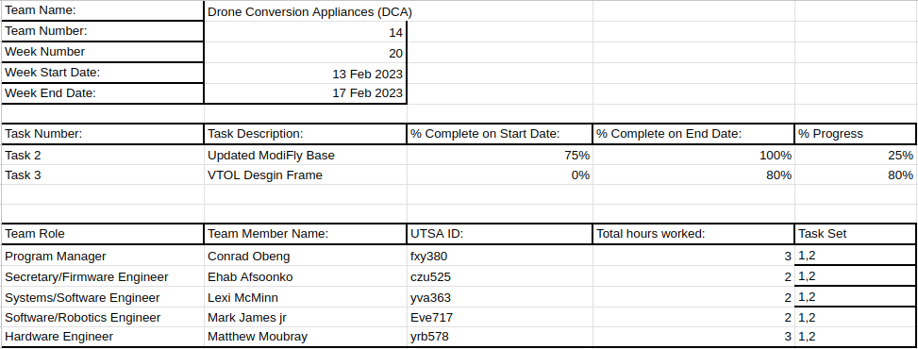
Week 20 Team Project Contribution Report

Slide 8
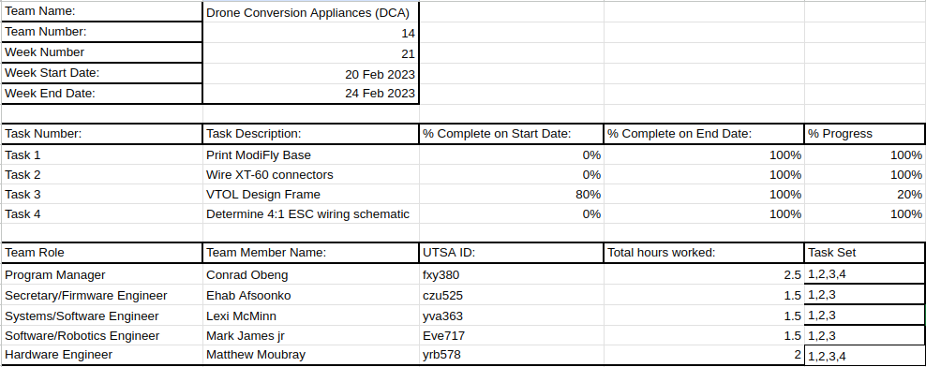
Week 21 Team Project Contribution Report

Slide 9
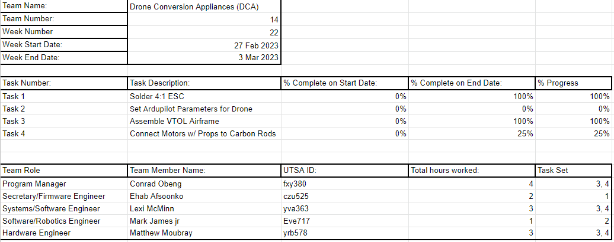
Week 22 Team Project Contribution Report

Slide 10
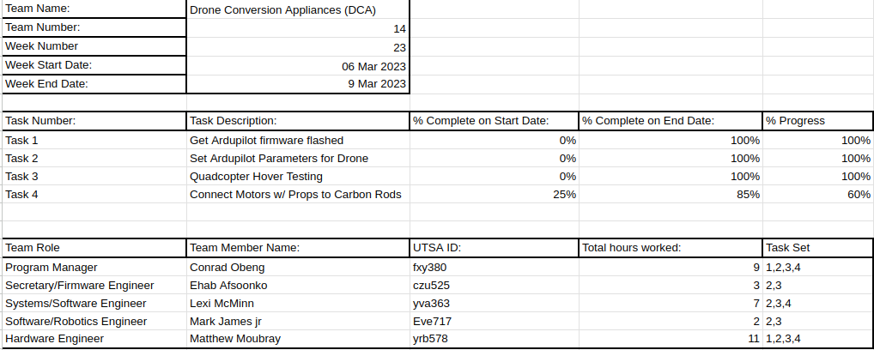
Week 23 Team Project Contribution Report

Slide 11
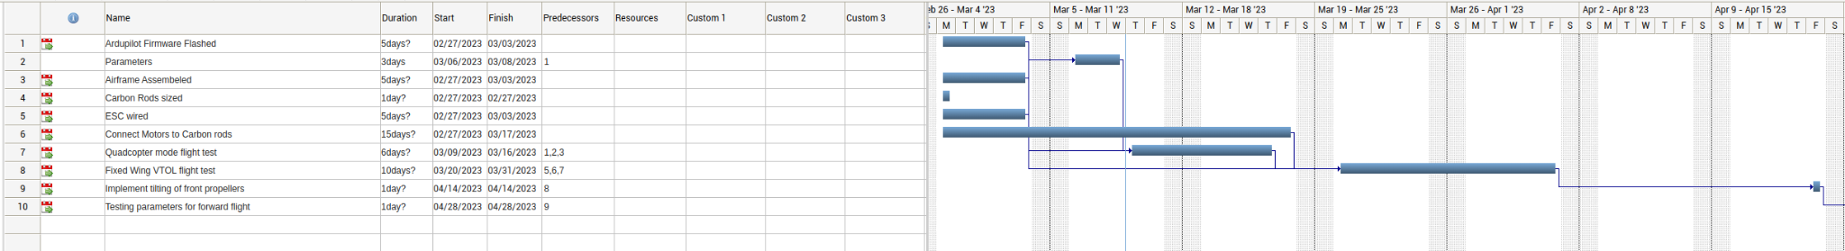
Work Breakdown Structure

Slide 12
Ongoing and Upcoming Tasks
Design and test attaching wings to the new base
3D print a connector that allows front propellers to tilt forward.
Verify the stability and structural integrity of new frame with wings attached during a hover test

Slide 13
Budget Slide
Item | Description | Cost
Pixhawk 2.4.8 | Flight Controller | $150
iFlight Xing-E Pro 2207(4pcs) | VTOL Motor | ~$66
HAKRC 45A 2-6S BLHeli_S 4in1 ESC | Motor ESC | $46
Turnigy Aerodrive SK3 | Forward Propeller Motor | ~$43.99
10x10x1000mm Carbon Fiber Rod | Carbon rods | $40

Slide 14
Budget Slide Con’t
Item | Description | Cost
Micro Metal Gear Digital Servo Motor x4 | Servo Motors | $15
4S LiPo Battery | Drone Battery | ~$70
3x8mm Screws x2 | Pivot Screws | $8
3mm Bolts x4 | Motor Bolts | $4
3x45mm Bolts x4 | Wing Mount Bolts | $7
3x20mm Bolts x4 | Tilt Mount Bolts | $6
3mm Washers x8 | Washers | $4

Slide 15





Biographies Slide
Ehab Afsnooko - Firmware Engineer - C++, Python, Verilog, embedded systems
Conrad Obeng - Engineering Manager - Python,Drone Engineering,Drone Firmware
Lexi McMinn - Systems/Software Engineer - C++,Python,Verilog,VHDL
Mark James Jr. - Software/Robotics Engineer- Python,C++,Java
Matthew Moubray - Hardware Engineer - C++, Python, LabView, eCalc, Solidworks

Slide 16
Questions?

